Slide 1
RAINFALL PREDICTION USING MACHINE LEARNING

Slide 2
Introduction
Climate is a important aspect of human life. So, the prediction should accurate as much as possible. In this project we try to deal with the prediction of the rainfall which is also a major aspect of human life and which provide the major resource of human life which is fresh water. Fresh water is always a crucial resource of human survival – not only for the drinking purpose but also for framing, washing and many other purposes. Making a good prediction of climate is always a major task now a day because of the climate change.
Now climate change is the biggest issue all over the world. People are working on to detect the patterns in climate change as it affects the economy in production to infrastructure. So as in rainfall also making prediction is a challenging task with a good accuracy rate. Making prediction on rainfall cannot be done by the traditional way, so scientist is using machine learning and deep learning to find out pattern for rainfall prediction. So, here Iam also using machine learning algorithms to predict rainfall.

Slide 3
Objective
Rainfall forecasting is very important because heavy and irregular rainfall can have many impacts like destruction of crops and farms, damage of property . So a better forecasting model is essential for an early warning that can minimize risks of life and property and also managing the agriculture farms in better way . This prediction helps farmers and also water resources can be utilized efficiently. Rainfall prediction is a challenging task and the result should be accurate.

Slide 4
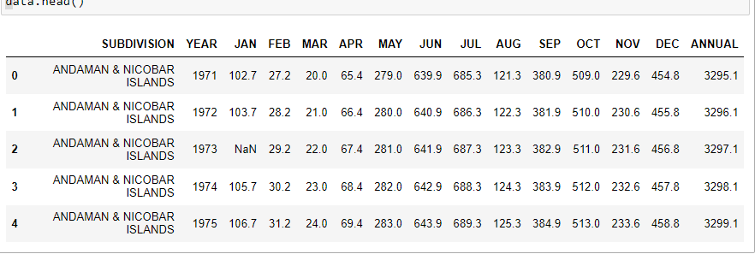
Data used
We have taken the values from past 1901 to 2015 including date and month by importing the libraries.
We are analyzing the data
And displaying the head of the dataset

Slide 5
Data exploration and pre-processing
Here, we are finding the shape of the data.
Shape of data is (1617,15)
We are checking the info of data
Then checking the duplicated values in data
Checking the data types and finding inconsistent values , then filling with mean.

Slide 6
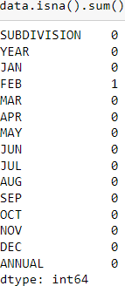
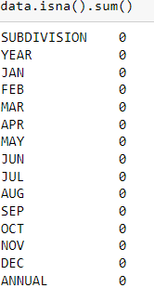
Data cleaning:
We have to check the null values in the dataset.
We have null values in our dataset
As we have null values, we need to fill it up with the mean value or median value.

Slide 7
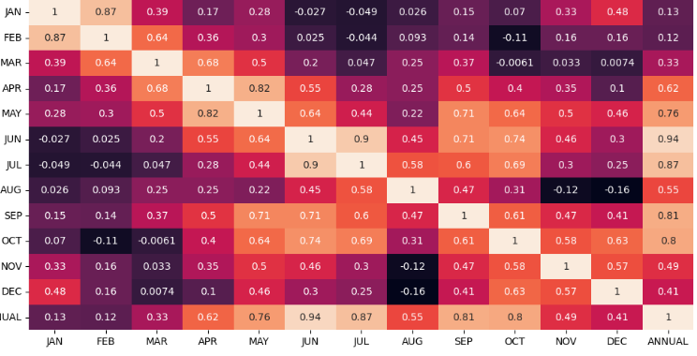
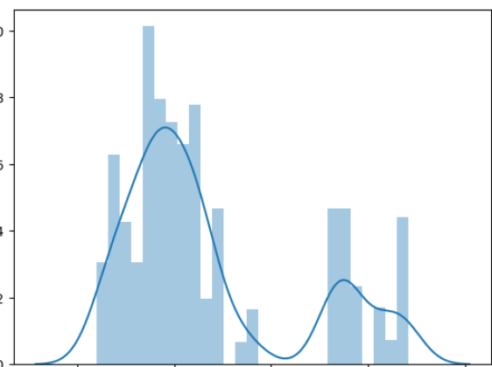
Data visualization
We have to describe and check the correlation
We have to visualize the data using scatter plot, histogram, grid, count plot, box plot and other which includes visualization.

Slide 8
Modeling and Checking accuracy
LINEAR REGRESSION
We are taking dependent (y) and independent (x) variables by using iloc .
And displaying the values of x and y
Importing the train _ test _ split library from sklearn. Model _ selection.
Training the dataset by using train _ test _ split library
Dis[playing the x _ train values.

Slide 9
We are using decision tree, Ada boost, Random Forest classifier, model, support vector machine and other models to predict the rainfall to find the accuracy of rainfall.
Linear Regression – 98% accuracy score
Decision tree – 99%
Random forest – 99%
Support Vector Machine – 97%
Ada Boost – 98%

Slide 10
Conclusion
This project investigates the use of machine learning methods and particularly suggests in improving the rainfall forecasting.
The rainfall data include the years of 1901 – 2015
We got the good accuracy by using all models.

Slide 11
THANK YOU

